Slide 1
STUDENTS’ EXAM PERFORMANCE REPORT
GROUP 8 PRESENTATION
DATA SCIENCE AND AI GROUP E CLASS
FACILITATOR – Mr. Balogun David

Slide 2
GROUP 8 MEMBERS
ACTIVE MEMBERS
1. OKAFOR UCHENNA RITA
2. FREDA ADDO
3. HANNAH ATERE
4. JESU-EBINIMIEDO ALAGHA
5. OLAITAN SURU
6. OOREOLUWA OLUSEGUN
7. MODUPE OLUMADE
8. RACHAEL HENRY
9. ESTHER ADEGBAMI
INACTIVE MEMBER
1. PRINCESS ONANGAYA

Slide 3
INTRODUCTION
Understanding and evaluating student exam performance is a critical aspect of educational assessment and improvement. This report delves into the comprehensive analysis of exam results for a group of 1000 students, aiming to provide insights into their academic achievements and areas that may require attention.
By examining performance across various subjects, identifying trends, and exploring potential influencing factors, we aim to contribute valuable information for educators, administrators, and stakeholders involved in enhancing the overall learning experience.
We intend to uncover patterns, highlight successes, and pinpoint opportunities for targeted interventions, ultimately supporting data-driven decisions to foster academic excellence..​..

Slide 4
PROJECT DETAILS
This dataset contains the exam performance report of 1000 students in the US, This sheet contains 8 columns namely: Gender, Race/Ethnicity, Parental level of Education, Lunch, Test preparation course, Math score, Reading Score, Writing Score.
The exam taken consists of 3 important subjects ; Reading, Writing and Math.
We carried out the following analysis to draw insights and make recommendations
1. GENDER ANALYSIS (Subjects Correlation)
2. CONTROLLING FACTOR ANALYSIS (Test preparation course, Parental Level of Education and Lunch Type)
Data Source : Kaggle
.

Slide 5
QUESTION 1
What are the Average scores in all tests taken for both male and female students?
ANSWER
We have the female students performing better than the male students in reading and writing with an average score of 73 and 72 respectively.
And the male students performing better than the female students in math with an average score of 69.

Slide 6
QUESTION 2
Does the parental degrees influence the performance of the students?
ANSWER
Students whose parents are master’s, bachelor’s and associate degree holders performed better than students whose parents are college and high school graduate.
Hence, from the chart below we can deduce that the parental level of education has an impact/influence on the student’s performance.

Slide 7
QUESTION 3
Which Ethnicity has the highest score?
ANSWER
Group E is the ethnicity with the highest average scores, having;
73 in Reading
74 in Math , and
71 in Writing.

Slide 8
QUESTION 4
Does the participation of the students in the test preparation course affects their overall performance in the exam?
ANSWER
The result of this chart shows that students who completed the test preparation course have higher scores compared to students who did not complete it
Hence, we could deduce that the students’ participation in the test preparation course affects their performance in the exam.

Slide 9
QUESTION 5
What is the average percentage score of the exam taken by the students?
ANSWER
The average percentage score of the exam taken by the students in Reading, Writing, and Math are 69%, 68%, 66% respectively
Overall, students performed better in Reading and Writing than they did in Math.

Slide 10
QUESTION 6
Does the lunch type affect the overall performance of the student in the test?
ANSWER
The result of this chart shows that students who have the standard lunch type performed better compared to students who have the free/reduced lunch type.
Hence, we could deduce that the lunch type the students have affected their overall performance in the tests.

Slide 11
QUESTION 7
What is the overall percentage of the student's performance? Who performed better between both gender?
ANSWER
The result of this chart shows that female student had 51% and the male students has an overall average score of 49%
The female students outperformed the male students by 2%.

Slide 12
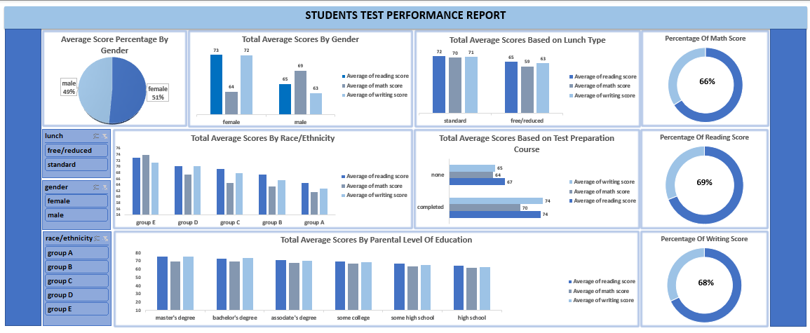

Slide 13
INSIGHTS AND RECOMMENDATIONS
GENDER ANALYSIS
SUBJECTS CORRELATION
We have a total of 518 female gender and 482 male gender
More female students passed their exams than male students, and on average, female students scored higher than male students by 2%.
Female students performed better in readings and writings, while male students performed better in math.
Two – thirds of the exam content is in readings and writing, and female students excel in these subjects.
RECOMMENDATION
More attention should be paid to the female students in math class and more attention to the male students in writing and reading classes to boost their performances in future exams.

Slide 14
INSIGHTS AND RECOMMENDATIONS
CONTROLLING FACTORS ANALYSIS
TEST PREPARATION COURSE (Revision)
Students who participated in the revision course performed better in the exams compared to students who did not participate/complete it.
Students with the least scores were found to have not completed the test preparation course.
Participation in test preparation course has a positive impact on academic performance of the students.
RECOMMENDATION
Students should be encouraged to complete the test preparation course, so that it gives them an idea of the exam content and improve their overall performance in future exams.

Slide 15
INSIGHTS AND RECOMMENDATIONS
CONTROLLING FACTORS ANALYSIS
LUNCH TYPE
Students who have the standard lunch type performed better than students who have the fee/reduced lunch type by 6%.
The lunch type of the students has a role to play in their performance in the exams.
The exam performance of the least students can be influenced by various factors such as nutrition, energy levels, and concentration.
RECOMMENDATIONS
Effort should be put into providing standardized and quality lunch for all students to foster equality and also help boost the performance of students with least scores.
Work collaboratively with parents to reinforce healthy eating habits both at home and at school.

Slide 16
INSIGHTS AND RECOMMENDATIONS
CONTROLLING FACTORS ANALYSIS
PARENTAL LEVEL OF EDUCATION
Students whose parents are master’s degree, bachelor’s degree, associate degree holders topped the chart and had the highest scores in the exam, while students whose parents are college and high school graduates appeared to have the lowest scores in the exam.
The parental level of education affects the overall performance of the students in the exam.
RECOMMENDATIONS
Parents who are college and high school graduates can encourage their kids to have personal study time, also engage in study groups with other top students.
Parents are also advised to engage home tutors for their kids, to boost their overall performance in future exams.

Slide 17
INSIGHTS AND RECOMMENDATIONS
RECOMMENDATIONS
Parental Involvement:​ Organize regular parent workshops to educate them on the curriculum, teaching methods, and how to support their child's learning at home. Establish a strong partnership between parents and educators for a more holistic approach.​
Explore Technology Integration:​ Integrate an online platform with adaptive learning features. Students receive personalized assignments based on their performance, allowing them to progress at their own pace with targeted content.​
Monitor Progress and Adjust Strategies:​ Implement formative assessments throughout the year to track students' understanding. If data indicates a common misconception, adjust teaching strategies immediately to address the misunderstanding.​
Professional Development for Educators: Conduct regular workshops for teachers on incorporating project-based learning methods, also Equip educators with innovative techniques to make lessons more engaging, fostering a dynamic learning environment.​
​

Slide 18
INSIGHTS AND RECOMMENDATIONS
RECOMMENDATIONS
Utilize Data-Driven Decision-Making:​
Use test data to identify that a specific teaching method correlates with improved student performance. Expand the use of this method across other classes, informed by the data-driven success observed.​
​
Promote a Positive Learning Environment and Celebrate Achievements:​
Host a quarterly academic awards ceremony, acknowledging students who have made significant improvements or achieved exceptional results.
This celebration creates a positive atmosphere and motivates others to strive for success. Also, Introduce a "Student of the Month" program, recognizing not only academic achievements but also positive behavior, leadership, and teamwork. This creates a positive culture that motivates students to excel in various aspects.​
​

Slide 19
CONCLUSION
Male students outperformed the female students in Math, while the female students performed better in Reading and Writing.
The overall performance of the female students was better than the male students.
The participation of students in the test preparation course and the lunch type that they have could be possible factors that affects the students’ grade
The parental level of education of the students has an impact in the overall performance in the exam.
The teaching approach adopted by teachers may need to be re-evaluated.

Slide 20
THANK YOU!!!

